Slide 1
Pimpri Chinchwad Polytechnic Nigdi Pune Program : Mechanical Engineering Course: Fluid Mechanics & Machinery

Slide 2
CHAPTER 3 Flow Through The Pipe
CO- Estimate Various Losses In Flow Through The Pipes.

Slide 3
Laws Of Fluid Friction For Laminar Flow
The frictional resistance is proportional to the velocity of flow
The frictional resistance is independent of the pressure
The frictional resistance is proportional to the surface area of contact
The frictional resistance varies considerably with temperature
The frictional resistance is independent of the nature of surface of contact

Slide 4
Laws Of Fluid Friction For turbulent Flow
The frictional resistance is proportional to the square of velocity of flow
The frictional resistance is independent of pressure
The frictional resistance is proportional to the density of fluid
The frictional resistance slightly varies with temperature
The frictional resistance is proportional to the surface area of contact

Slide 5
Darcy's Equation For Frictional Losses
The loss of head in pipes due to friction is calculated from Darcy's equation
hf= 4fLV2
2gD
f- coefficient of friction
L- Length of pipe
V-Velocity of fluid
g-Gravitational constant
D- Diameter of pipe

Slide 6
Chezys equation
Consider uniform horizontal pipe Where is, h_{f} = f’/ γ. P/A X L V² We know, hydraulic radius is the ratio of area of flow to wetted perimeter. It is denoted by ‘m’. m = A/P = π/4d² / πd = d/4 P/A = 1/m put value of P/A in Equation, h_{f} = f’/ γ. 1/m. L V²

Slide 7
Chezys equation
V² = h_{f}. γ.m / f’.L V = √ γ / f'. h_{f} / L. m Consider √ γ / f' = C i.e. Chezy’s constant and h_{f} / L = I i.e. loss of head per unit length of pipe. Put the above value in Equation, V = C√m i This is known as Chezy’s formula.

Slide 8
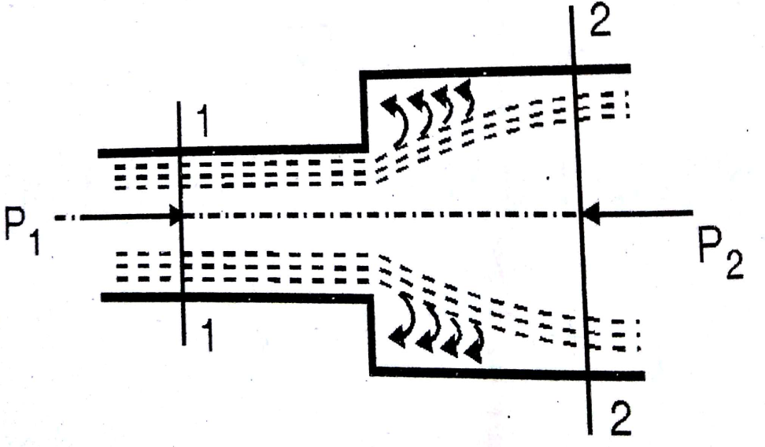
Minor losses
Loss due to sudden enlargment
hl = (V1-V2)2
2g
Where V1 & V2 are velocities on the two sides or the section at which sudden enlargement occurs

Slide 9
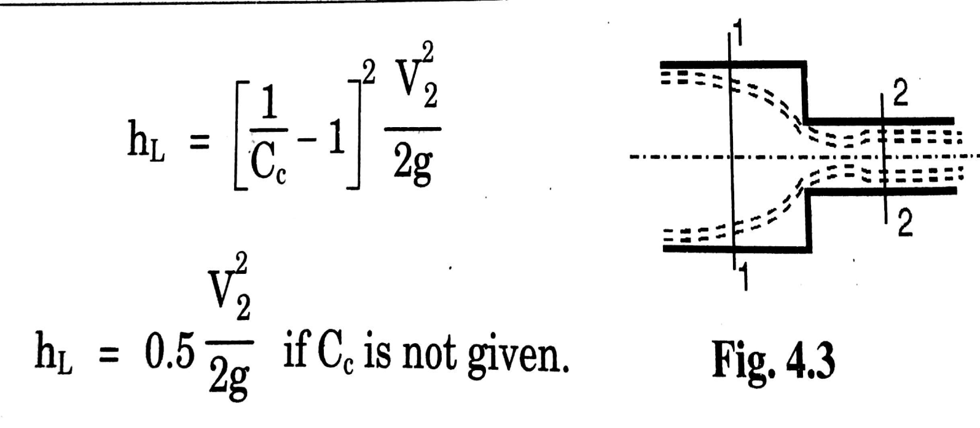
(b) Loss due to sudden contraction

Slide 10
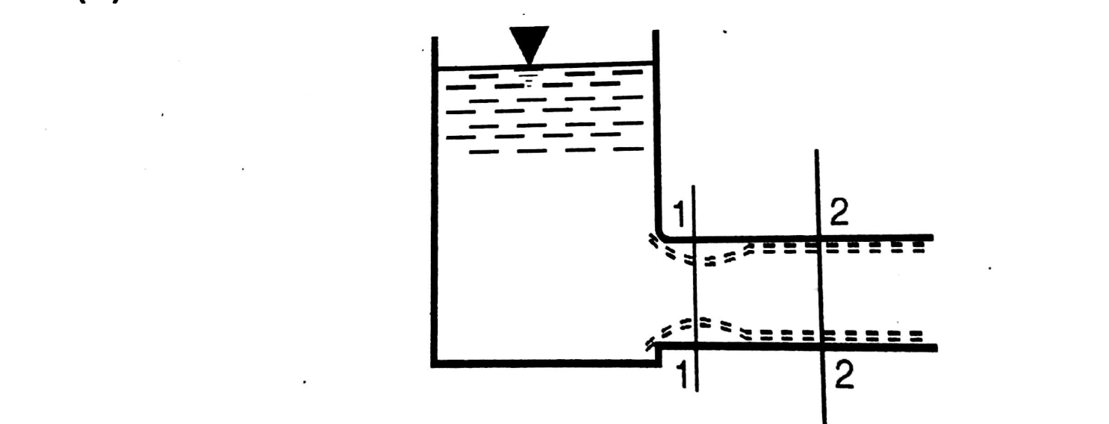
Loss at the entrance
he=0.5 V2
2g
V= Velocity of fluid in pipe

Slide 11
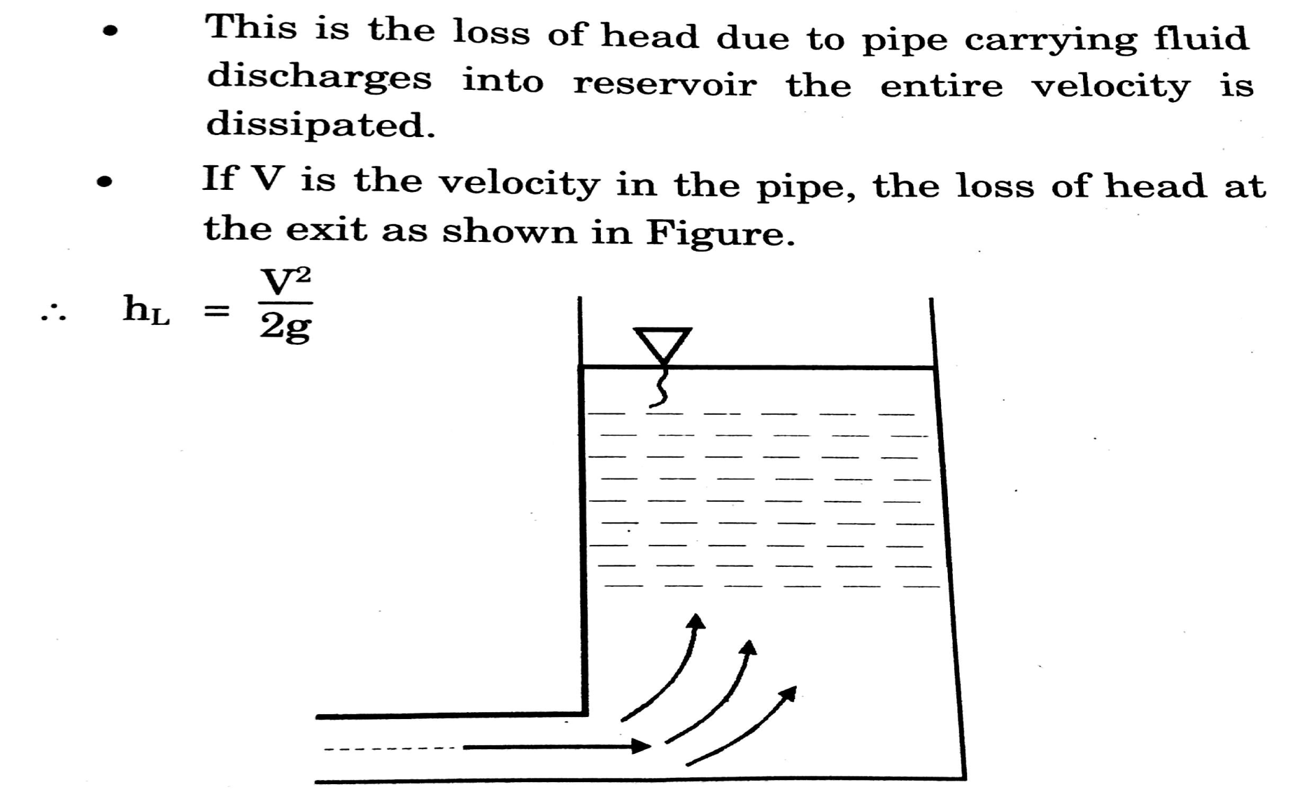
Loss at exit

Slide 12
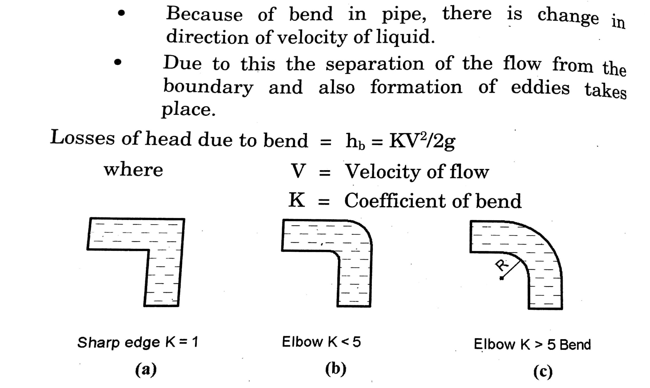
Loss of head at bend or pipe fitting

Slide 13
Hydraulic Gradient Line (H.G.L)
In closed conduits flowing under pressure, the hydraulic grade line is the level to which water would rise in a vertical tube (open to atmospheric pressure) at any point along the pipe. HGL is determined by subtracting the velocity head (V2/2g) from the energy gradient (or energy grade line).

Slide 14
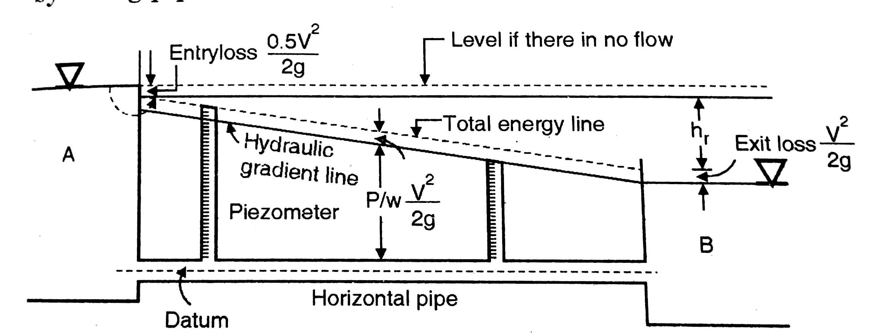
Hydraulic Gradient Line (H.G.L)

Slide 15
Total Energy Line (T.E.L)
A line that represents the elevation of energy head (in feet or meters) of water flowing in a pipe, conduit, or channel. The line is drawn above the hydraulic grade line (gradient) a distance equal to the velocity head (V²/2g) of the water flowing at each section or point along the pipe or channel.

Slide 16
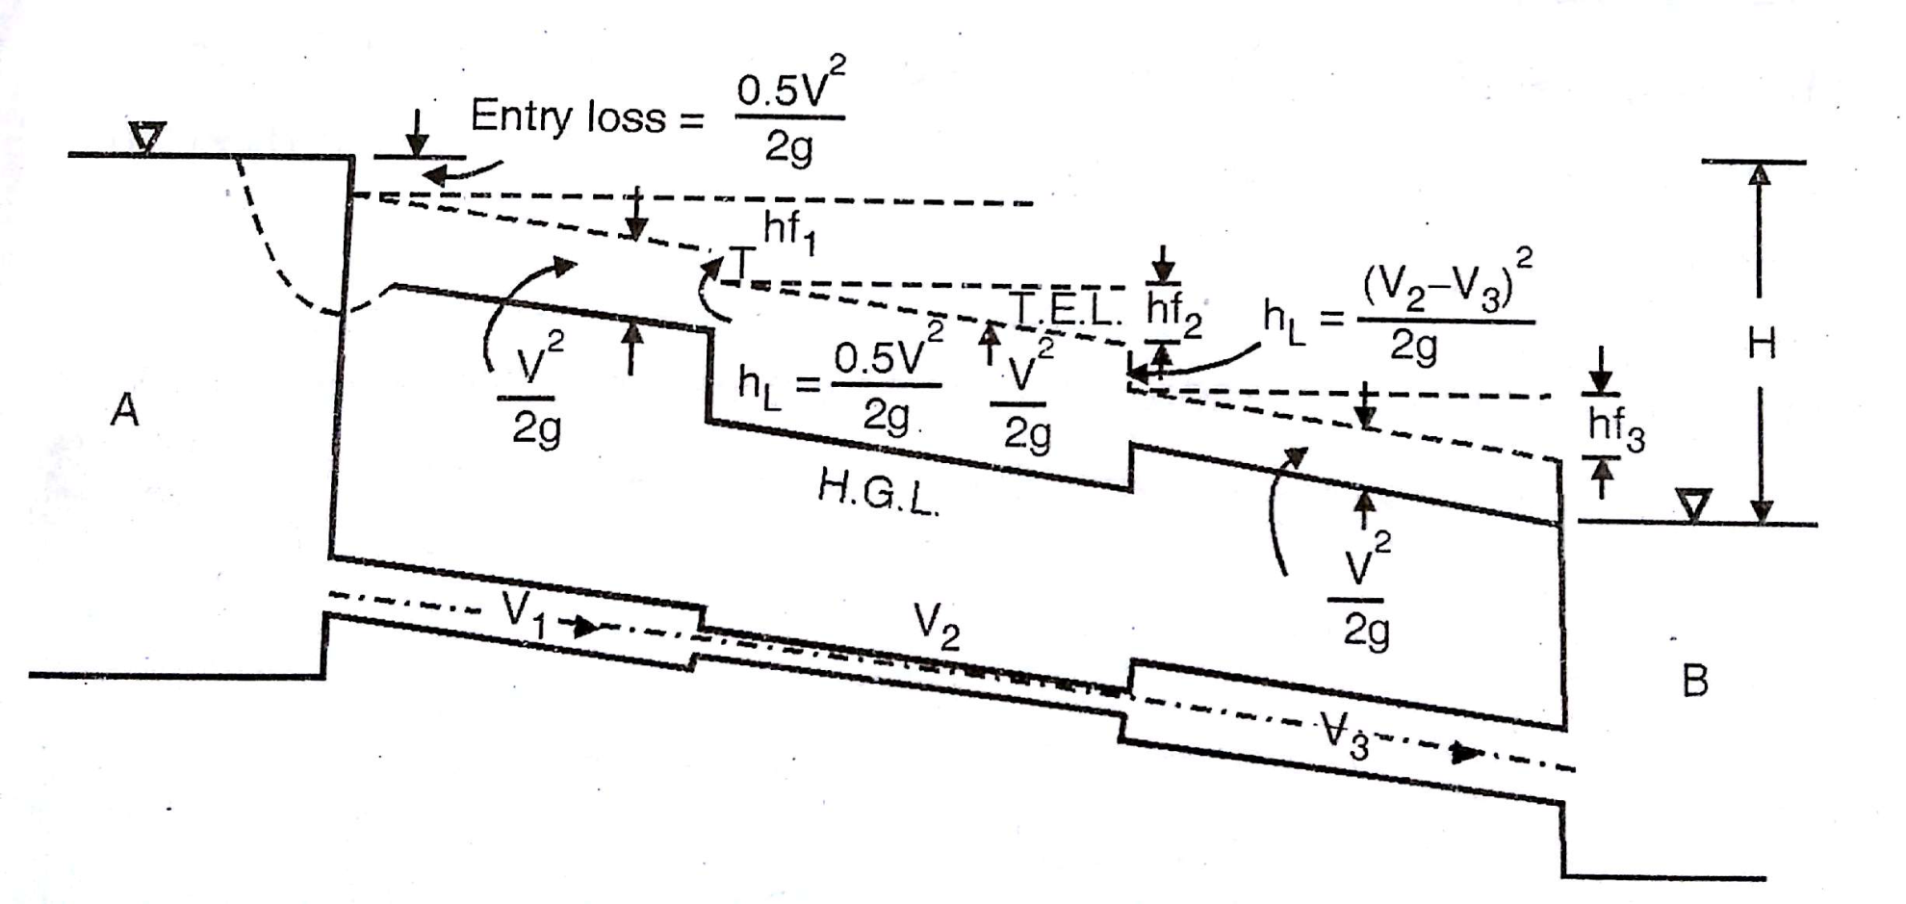
Total Energy Line (T.E.L)

Slide 17
Water Hammer
When a pipe is suddenly closed at the outlet (downstream), the mass of water before the closure is still moving, thereby building up high pressure and a resulting shock wave. In domestic plumbing this is experienced as a loud banging resembling a hammering noise. Water hammer can cause pipelines to break if the pressure is high enough. Air traps or stand pipes (open at the top) are sometimes added as dampers to water systems to absorb the potentially damaging forces caused by the moving water.

